Slide 1

SonarQube
Setting up Gradle Project Jenkins & SonarQube
Presented By :
Amrit Choudhary

Slide 2

On boarding Gradle projects
Pre- Requisites
JDK 1.8 or higher
Verify java version cmd : java -version

Slide 3
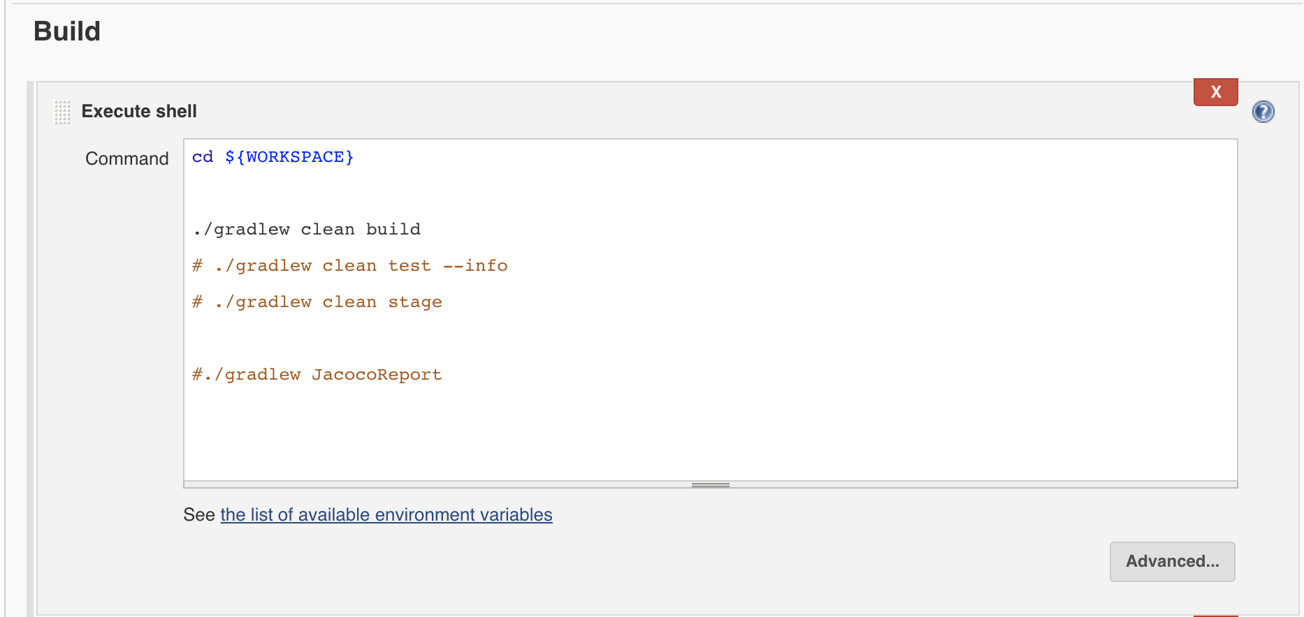
On boarding Gradle project on Jenkins
Follow the Video & Snapshots for reference

Slide 4
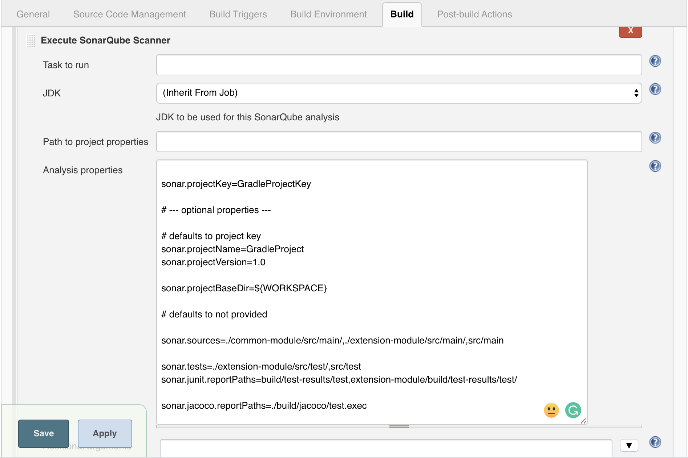
On boarding Gradle project on Jenkins Sonar Scanner

Slide 5
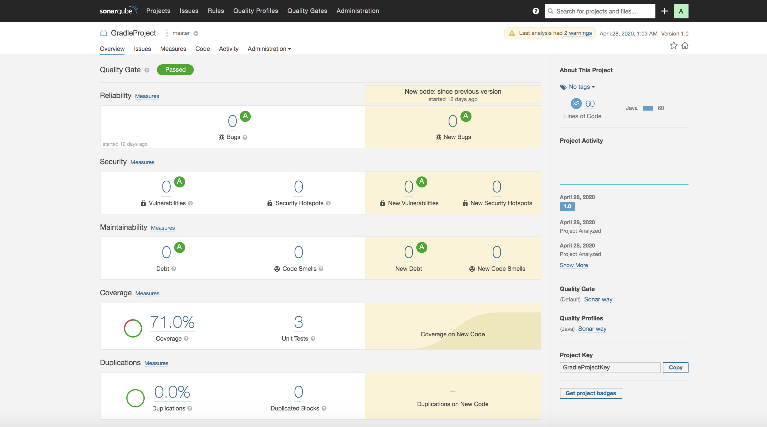
Run Jenkins Gradle Job : Final Result SonarQube

Slide 6
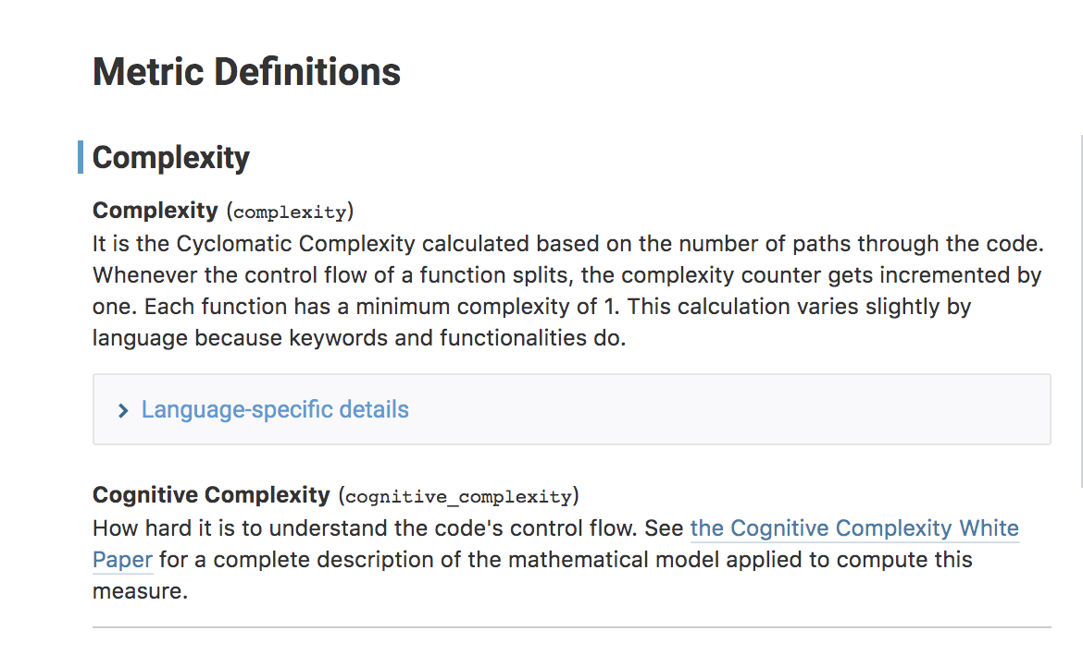
Understanding Complexity

Slide 7
Congrats !!!
Gradle Project is on boarded successfully.
Git repo for maven: https://github.com/trainmefordevsecops/gradle-project-multi-module.git
References:
https://docs.sonarqube.org/latest/user-guide/metric-definitions/

